Slide 1


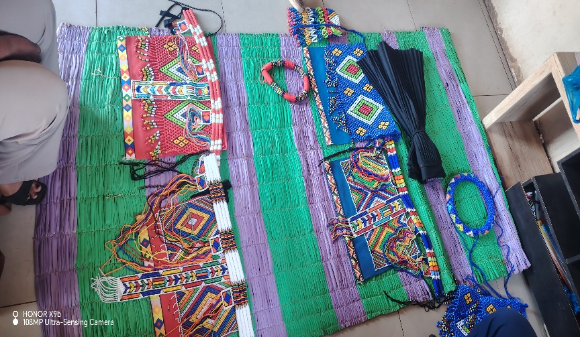
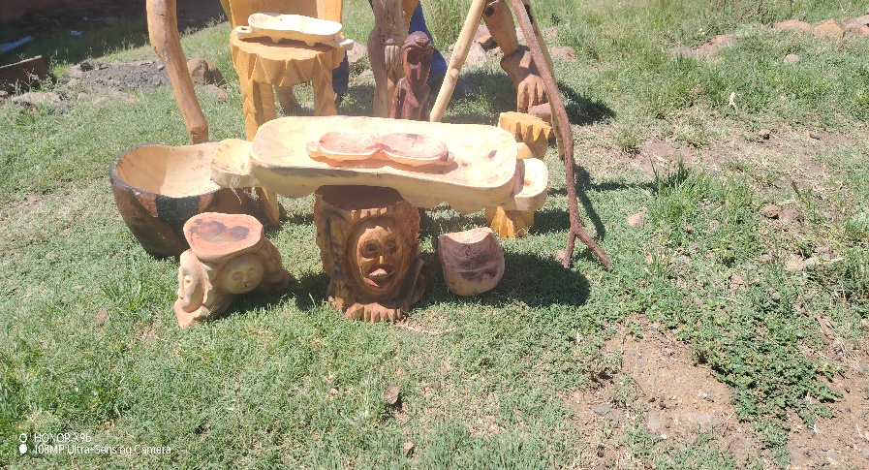
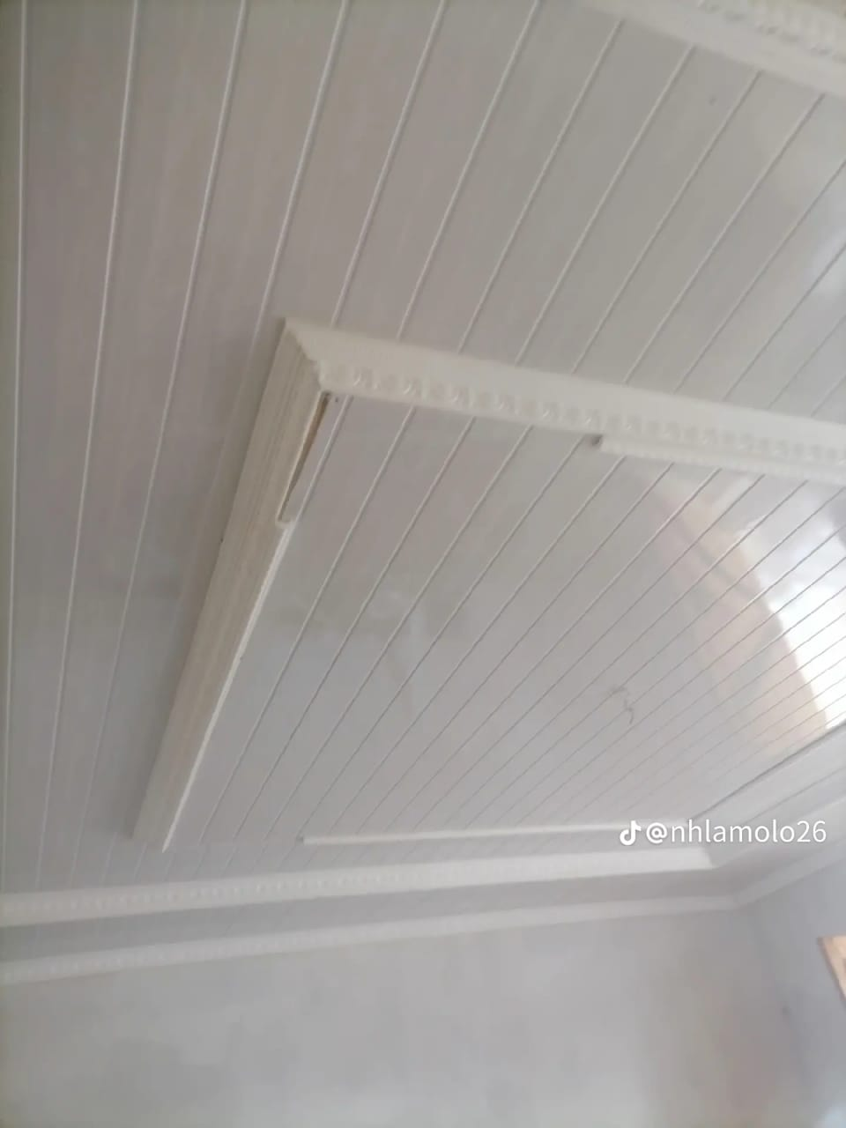
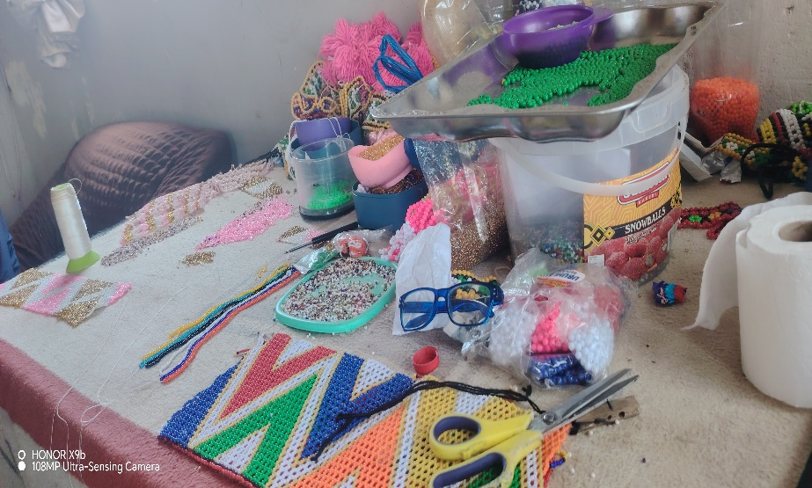
LETS US SUPPORT LOCAL BUSINESS
VISIT OUR WWW.UEDA.CO.ZA OR CALL MISS MTHEMBU FOR ENQUIRIES- 0829289404

Slide 2
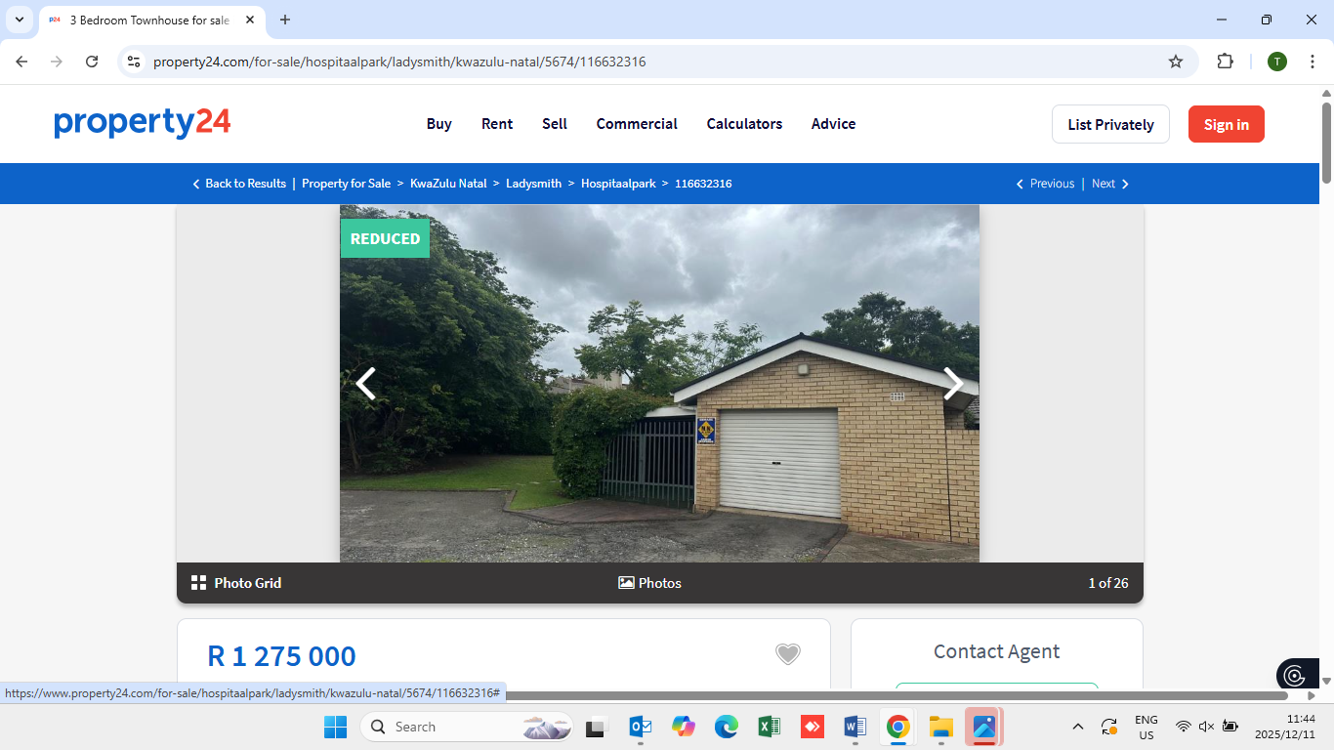
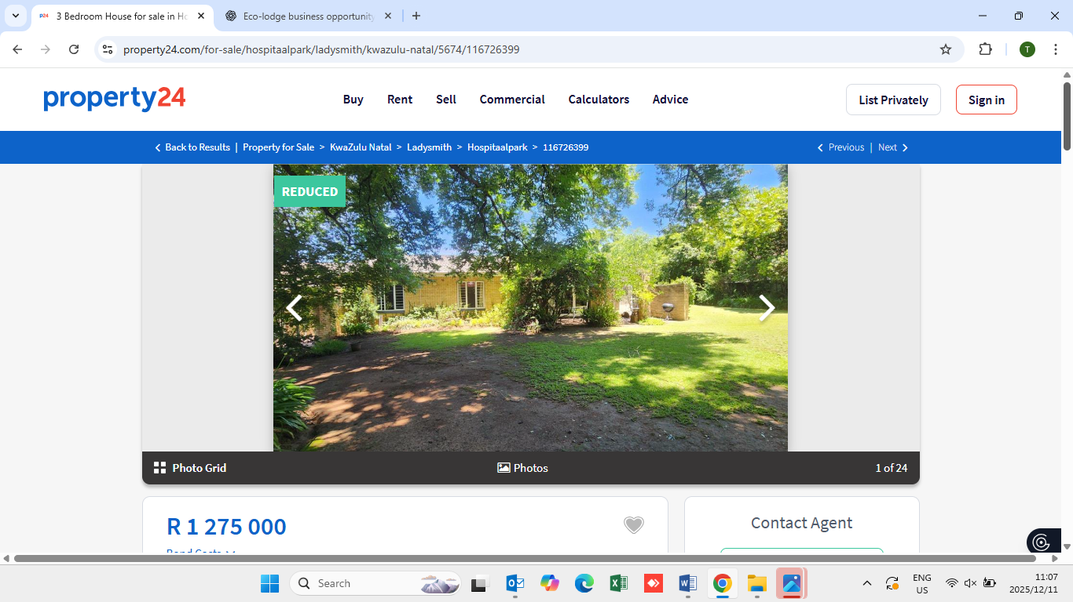
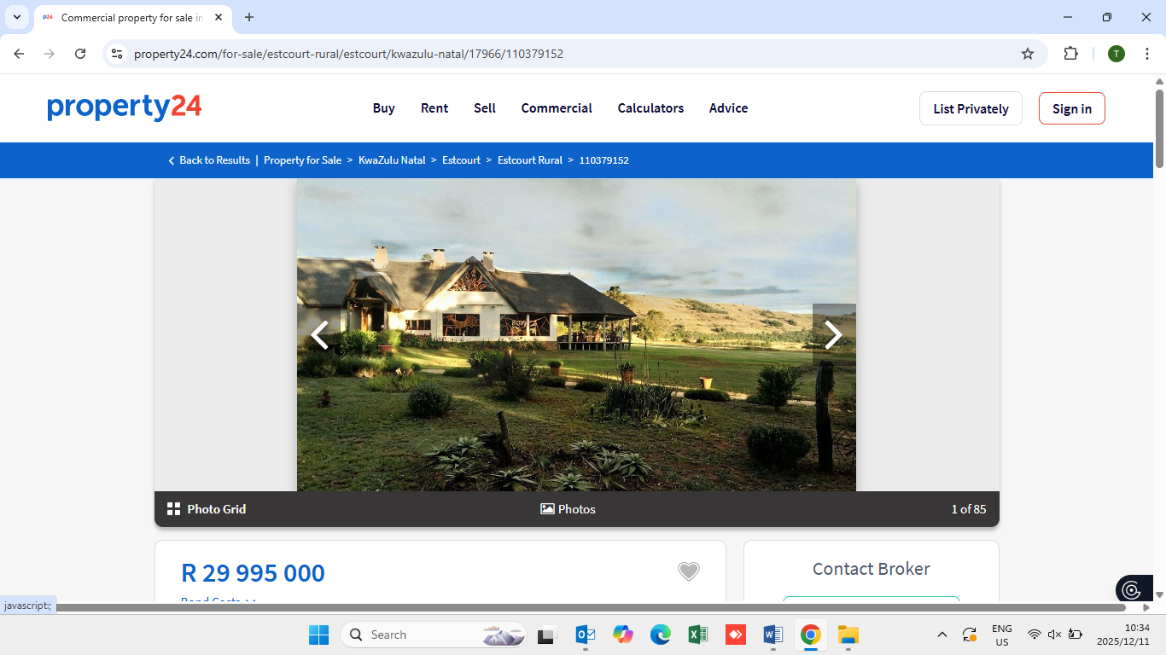
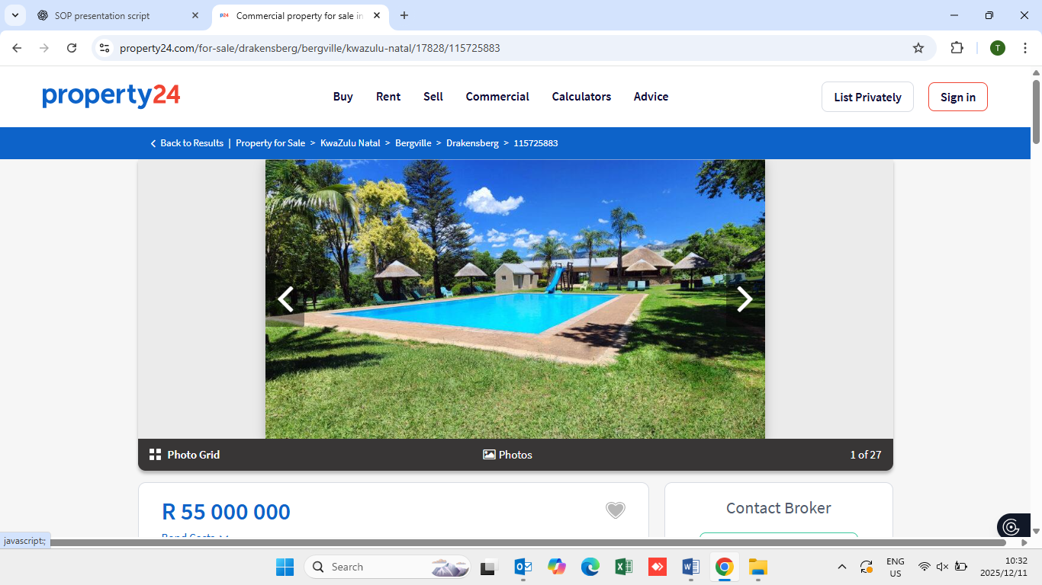
LETS US SUPPORT LOCAL BUSINESS
VISIT OUR WWW.UEDA.CO.ZA OR CALL MISS MTHEMBU FOR ENQUIRIES- 0829289404

